Slide 1
Yoga Posture
Classification and Grading
AI Innovators: Melita Madhurza, Caleb Kim, Minji Woo

Slide 2
Introduction
Background:
Growing popularity of home yoga,
Beginners lack expert guidance on maintaining precise postures
Project Goal:
Develop a yoga posture recognition model to classify five yoga poses from static images
Contribute to future model development for real time feedback and posture correction

Slide 3
Past Research
A Computer Vision-Based Yoga Pose Grading Approach Using Contrastive Skeleton Feature Representations by Yubin Wu et al.
BlazePose model for pose estimation through skeletal keypoint extraction
Contrastive learning to enhance pose feature representation
Focused on grading yoga poses
Real-time Pilates Posture Recognition System Using Deep Learning Model by Hayoung Kim et al.
BlazePose model for pose estimation
Implemented deep learning-based classification of 8 Pilates and unknown postures
Optimized for real-time recognition with a lightweight architecture

Slide 4
Method

Slide 5
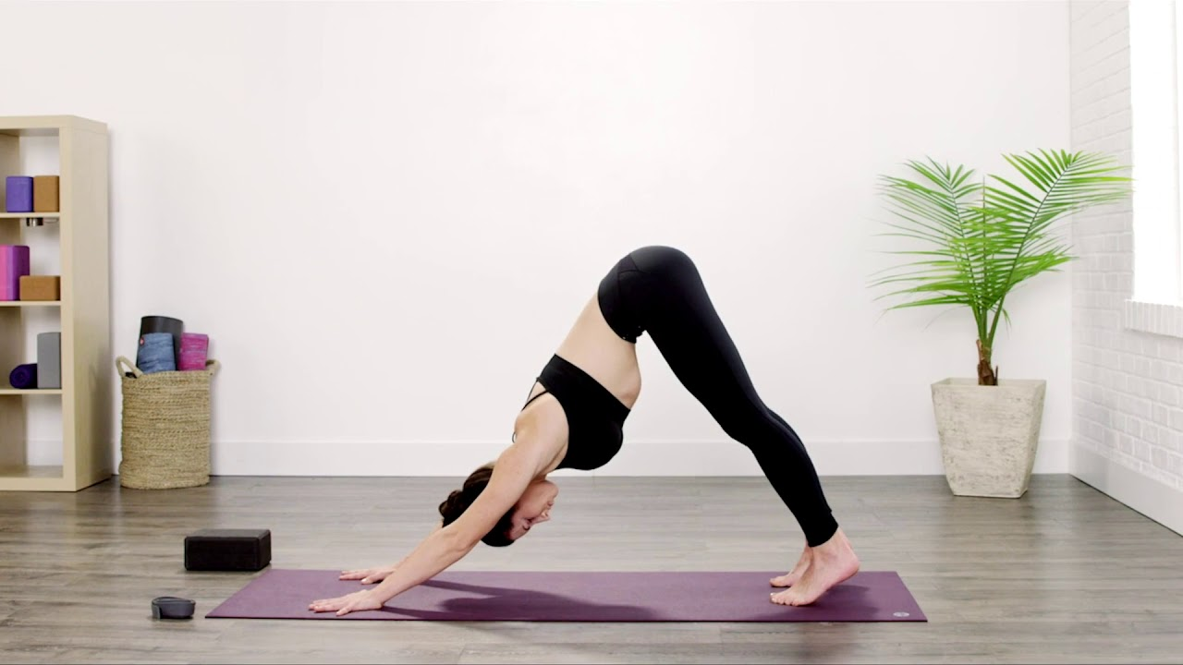
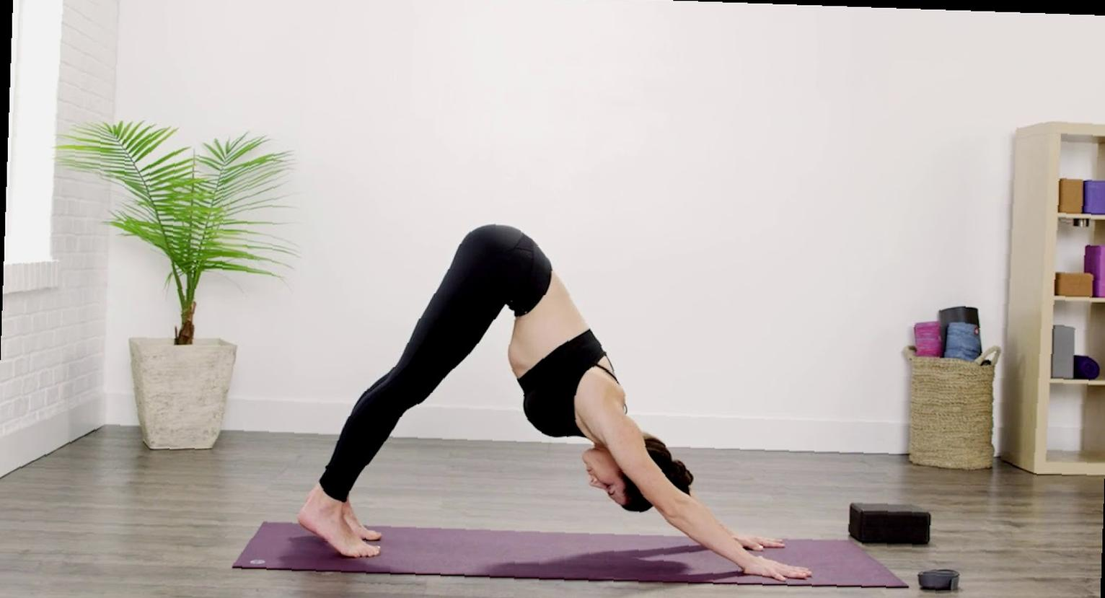
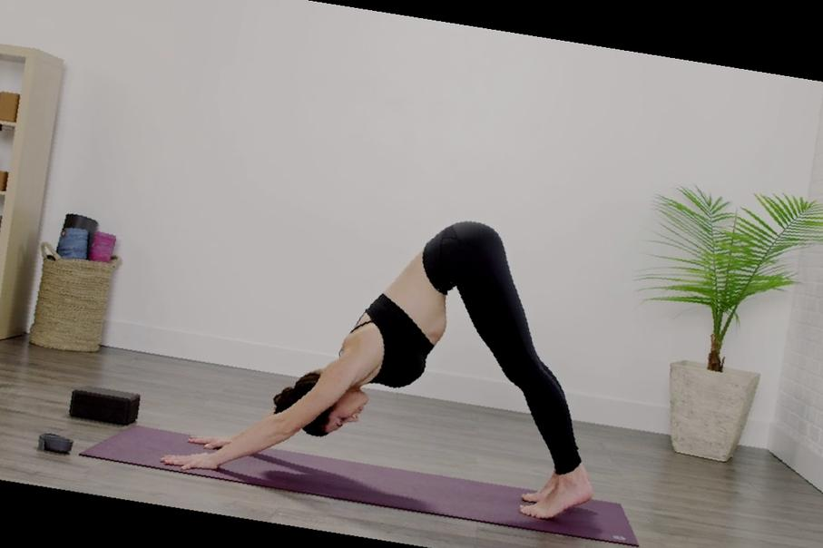
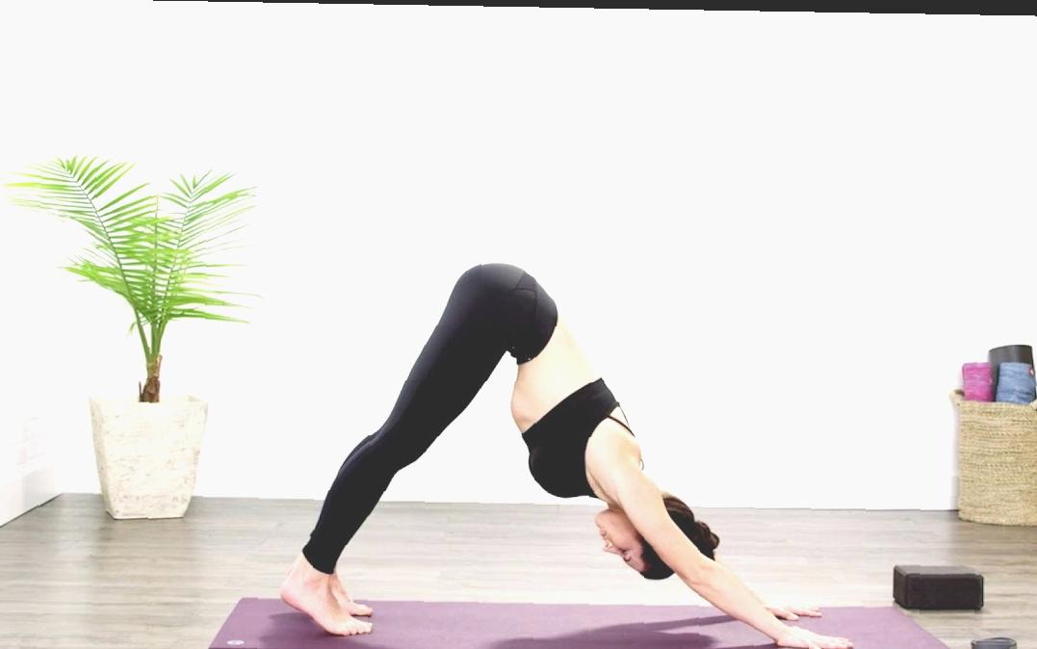
Dataset
Dataset originally sourced from Kaggle with 5 yoga poses
Down Dog, Goddess, Plank, Tree, and Warrior II
Initial dataset was limited, so we utilized data augmentation to expand it
Final dataset consists of 6119 training, 277 validation, and 465 test images
Each image is represented by a 99-dimensional feature vector using MediaPipe BlazePose
Original image

Slide 6
Baseline Model
Goal: Create a simple regression model to establish a baseline performance for yoga pose classification.
Approach:
Leveraged the extracted BlazePose landmark features (99-dimensional vector) to train the model
Employed logistic regression to establish a baseline performance for yoga pose classification
Evaluate the model’s performance using accuracy score and classification report

Slide 7
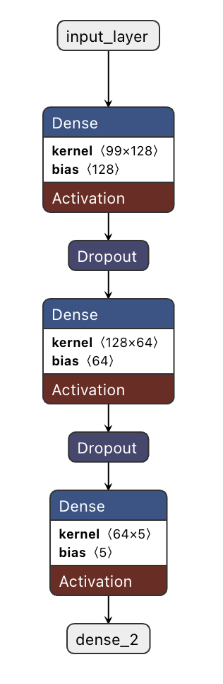
Deep Learning Model
Goal: Improve accuracy and generalization using a neural network, as the baseline regression model has limited conv layers
Approach:
Built 3 dense layers with ReLU activations and Dropout regularization, trained on BlazePose landmark features
Architecture:
Input layer: 99-dimensional feature vector (BlazePose landmark features)
Hidden layers: 2 Dense layers with 128 and 64 units, respectively
Output later: Dense layer with 5 units (one for each class)
Trained for 30 epochs

Slide 8
Results and Evaluation

Slide 9
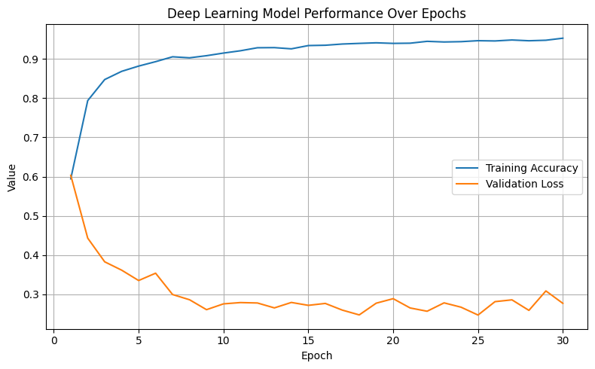
Results
Baseline Model:
Achieved a validation accuracy of 85.56%
Test accuracy: ~93.
Deep Learning Model:
Validation accuracy: ~94% (during training)
Test accuracy: ~97.63%
Classification report: shows high precision, recall, and F1-score for each class
Notes:
Summary:
Model can effectively classify yoga poses using BlazePose landmark features
Deep learning model achieves high accuracy on both validation and test sets

Slide 10
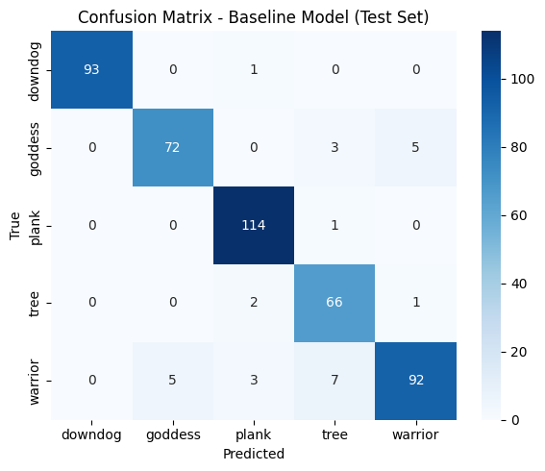
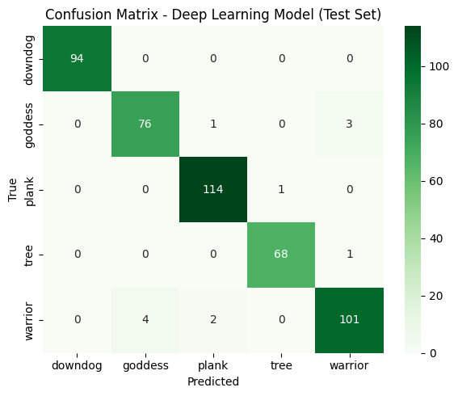
Evaluation
Baseline Model (~94% accuracy):
Performs relatively well but struggles with more complex poses (For example, warrior vs. tree)
Deep Learning Model (~98% accuracy)
Learned better pose distinctions
Noticeable higher precision, recall, and F1-scores across all different poses.
Conclusion
Deep learning outperforms the baseline model
Training and validation trends showed stable learning with no major overfitting
Deep Learning takes longer but generalizes better.
Notes:
Steps we plan to take:
First, we partitioned our dataset into training, validation, and testing subsets. About 10% of the training data will be reserved for validation so that we can monitor potential overfitting. Later in the process, the test dataset, which is completely separate, will be used to provide a final unbiased evaluation of the model’s performance.
- Accuracy (to evaluate a general model performance by measuring % of correct yoga pose predictions)
- Precision per pose: when the model predicted a certain pose, measures how often it was right
- Recall per pose: measures out of the actual pose images, how many did the model correctly identify.
- We will monitor categorical cross-entropy loss during training and validation. We want to see if the model might be overfitting if the validation loss begins to diverge significantly from the training loss – in this case we will modify our model.
(Reading off the line on the slide should be enough)
“
“ (we expect a significant improvement in accuracy, robustness, and generalization for our fine-tuned MovileNetV2)

Slide 11
Discussion
Strengths of Deep Learning Model:
BlazePose model allows accurate pose extraction using skeletal features.
High test accuracy (~97%) demonstrates strong model performance.
Challenges:
Dataset limitations: small number of images per class may impact generalization.
Pose variability: poses with more complex movements (e.g., Warrior) had lower accuracy.
Future Improvements:
Expand dataset for more diverse poses.
Extend the model to real-time feedback and posture correction.

Slide 12
THANK YOU!

